Slide 1
Random Python Tools
Eric Prebys
Phy 40
Fall 2025

Slide 2
Tools We Won’t Discuss Elsewhere…
sympy
  Python symbolic manipulation package.
pickle
  Useful for storing objects and data
OS tools
  OS information
  File access
GUI controls
  Tkinter (python)
  ipywidgets (native jupyter)
Asynchronous processes
TCP/IP Communication

Slide 3
Symbolic Python (sympy)
Symbolic python (sympy) is a powerful Computer Algebra System (CAS) tool; that is, it’s a tool for handling symbolic mathematical operations.
Good substitute for things like Mathematica, Maple, and the CAS part of Matlab.
  All of which have their own learning curve and cost money.
  Sympy is extremely intuitive and easy to use.
Capabilities include
  Integration.
  Differentiation.
  Analytical and numerical root finding.
  Plotting
  Matrix and vector operations
  LaTeX rendering
(go to demo)
Very handy for these!

Slide 4
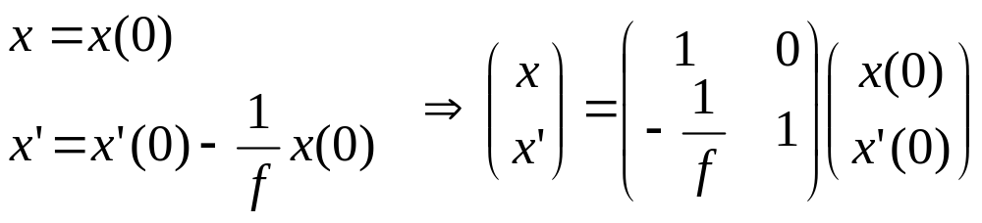
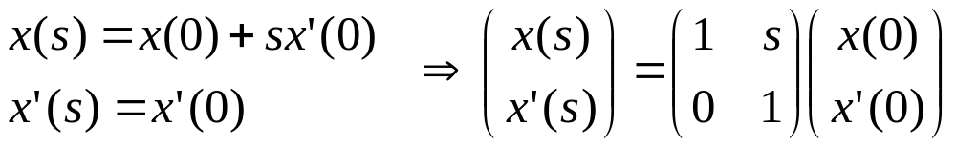

Classical Optics Example
If we use the ”parallax” approximation for small angles
Then we can represent lenses and “drifts” by “transfer matrices”..
Transverse position
Lens:
Slope wrt axis
Drift:

Slide 5
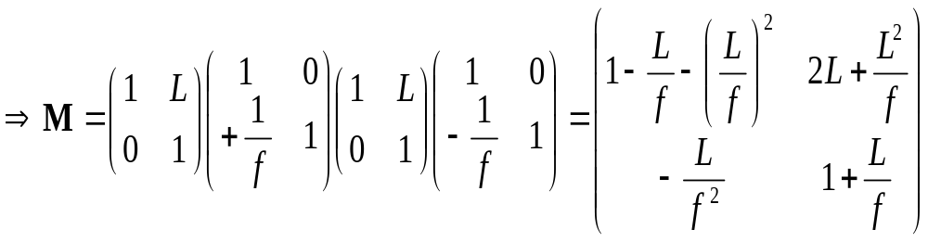
Classical Optics Example (cont’d)
Representing a system of lenses and drifts
f
-f
L
L
Remember: motion is usually drawn from left to right, but matrices act from right to left!
?
(go to demo)

Slide 6
Pickle
Pickle is a powerful tool for storage and recovery of arbitrarily complex structures in Python
  This include objects, including both their data and methods
Similar to serializability in Java.
No truly equivalent tool in C++
(go to demo)

Slide 7
Accessing System Information
Recall that jupyter works on a client/server model
For everything you do in this class, these are both running on the same machine, but this isn’t always the case
  Often jupyter servers will be set up on remote systems to access software ecosystems, computing capabilities, etc
    Example: Google Colab
  The server may even be running on hardware
    Example: Pynq board
Remember that when you’re accessing the system, you’re accessing the server system.
Client: browser interface
Server: where everything actually runs
(go to demo)

Slide 8
Graphical User Interface (GUI)
The GUI is the biggest difference between standalone python and a jupyter notebook.
The two main python GUI packages are
  qt5
  tkinter (this one seems to be winning)
These packages open windows from the server rather than the client, so they can only be used if the server and the client are running on the same computer
  This is how we’re doing it in this class but that may not always be the case.
The native GUI tools in Jupyter use “ipywidgets”
  These run inside the jupyter window like all other graphics
  They’re not nearly as good as qt5 or tkinter
  They CANNOT run in standalone python
(go to demo)

Slide 9
Asynchronous Operation
As you may have noticed, you can run cells in a jupyter notebook in a different order, but they still execture sequectially
  A new cell will not execute until the previous one has completed.
Sometimes, you might want code to execute asynchronously; that is, run two or more processes at the same time.
  Eg, you might have one process waiting for data and another one processing the data.
The package for doing this is “asyncio”
(go to demo)

Slide 10
TCP/IP Communication
It’s easy to communicate between Python processes using TCP/IP communication.
  Again, this is particularly useful when communicating with hardware.
The TCP/IP library uses “sockets” for communication.
The destination of a TCP/IP packet is specified by a 4 byte “IP Address” and a 16 bit “port”
  Thing of it as a phone number and an extension
  IP address “127.0.0.1” is a loopback address to the local system
  Ports are allocated
    0-1023: Reserved for essential things like HTTP, FTP, etc
    1024-49151: Registered for specific applications and services
    49152-65535: Private/temporary ports that can be used for general communication.
(Go to demo)

